Slide 1
Mapping Requirements into a Software Architecture

Slide 2
An Architectural Design Method
Customer Requirements
"four bedrooms, lounge, drawing & dinning,
lots of glass ..."
Architectural Design

Slide 3
Deriving Program Architecture
Program
Architecture

Slide 4
Structured Design
objective: develop a modular program structure and represent control relationships between modules
approach:
  the DFD is mapped into a program architecture
  the PSPEC and STD are used to indicate the content of each module
notation: structure chart

Slide 5
Structured Design
It provides a convenient transition from a data flow diagram to software Architecture
  The type of information flow is established
  Flow boundaries are indicated
  The DFD is mapped into program structure
  Control hierarchy is defined
  Resultant structure is refined using design measures and heuristics
  The architectural description is refined and elaborated

Slide 6
Types of Information Flow
There are 2 different types of information flow that have different treatments
  Transform flow - Overall DF in sequential manner and follows one, or only a few, “straight line” paths. (incoming, transform, output)
  Transaction Flow - Info flow has a single transaction node that triggers other data flow

Slide 7
Transform Flow
  Incoming Flow: The paths that transform the external data into an internal form
  Transform Center: The incoming data are passed through a transform center and begin to move along paths that lead it out of the software
  Outgoing Flow: The paths that move the data out of the software
Transform flow

Slide 8
Transform Analysis: mapping heuristic
i1
tc1
o1
o2
i2
tc2
o3
sys
I-ctrl
P-ctrl
O-ctrl
i1
i2
tc1
tc2
o1
o3
o2

Slide 9
Transaction Flow
  Information flow is often characterized by a single data item, called a transaction that triggers other data flow along one of many paths
  Action Paths :The transaction is evaluated and based on its value flow along one of many action paths
  Transaction center :The hub of info flow from which many action paths originate
Transaction
flow

Slide 10
Transaction Analysis: mapping heuristic
r1
sys
r2
trc
r2
trc
r1
s1
s2
i1
i2
i1
cot
o1
cot
i2
o1

Slide 11
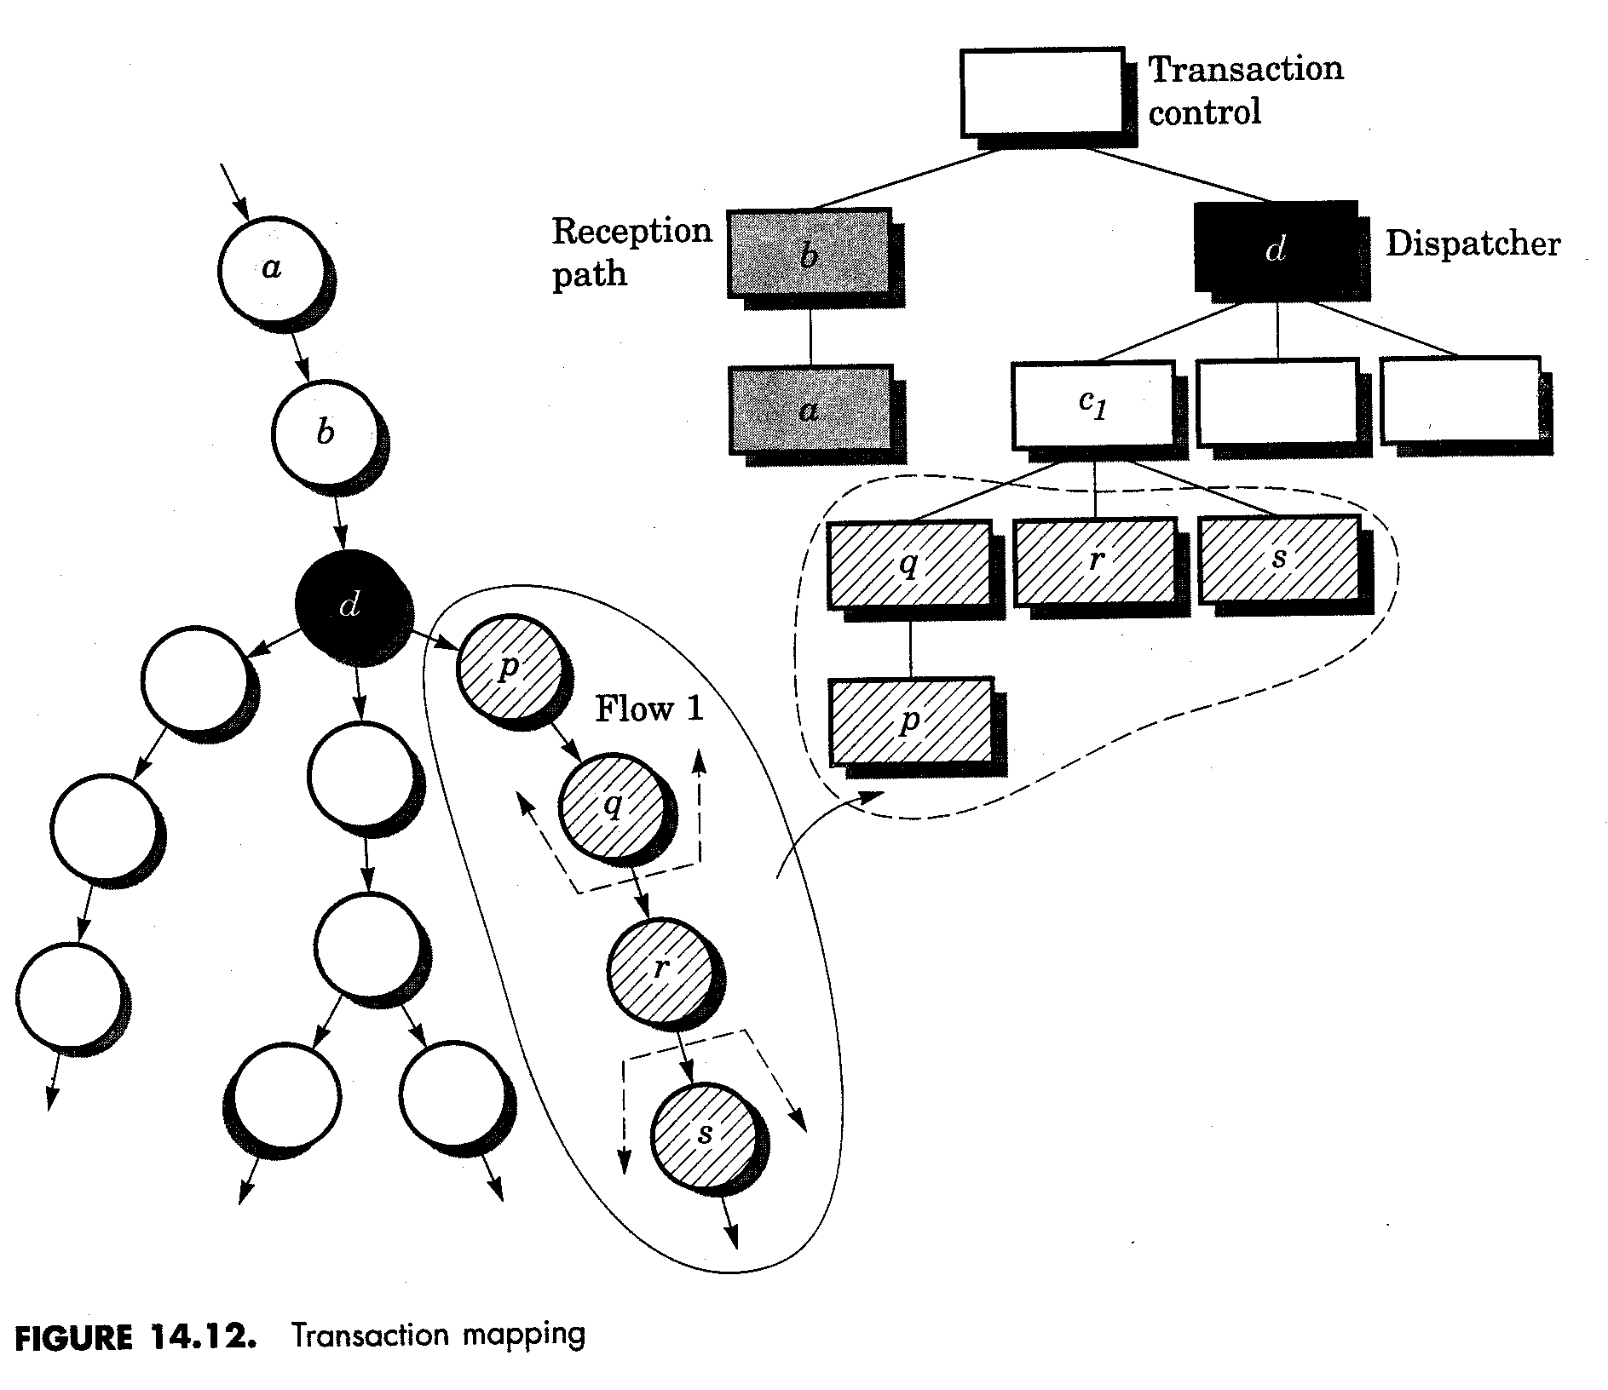
Transaction Mapping

Slide 12
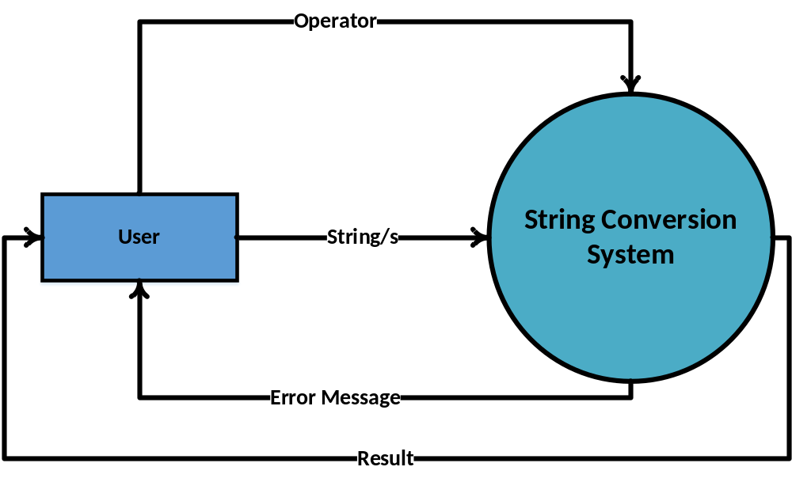
String Conversion System: Context Level DFD

Slide 13
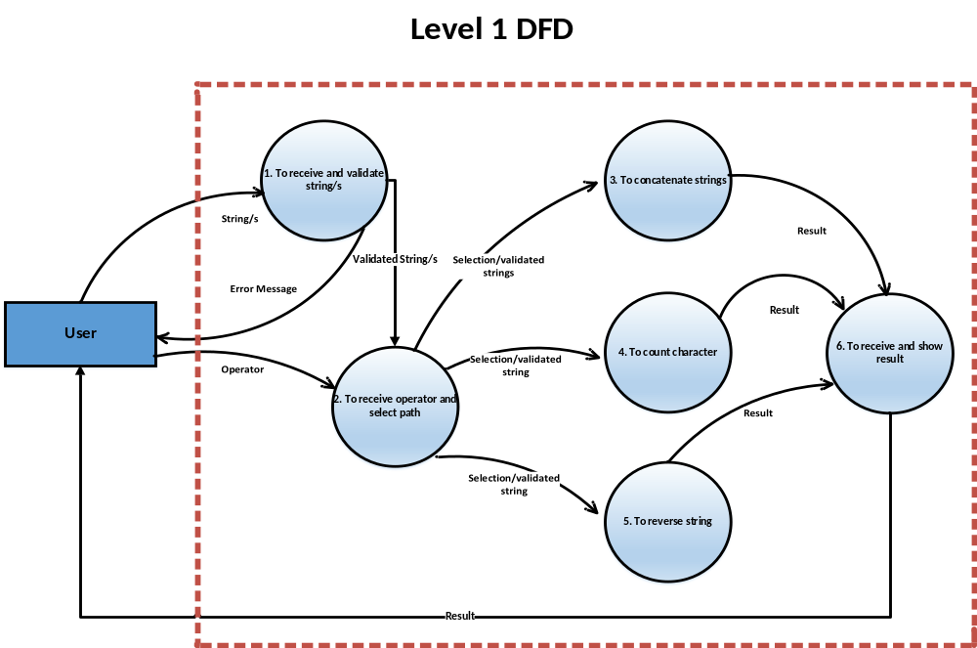
String Conversion System

Slide 14
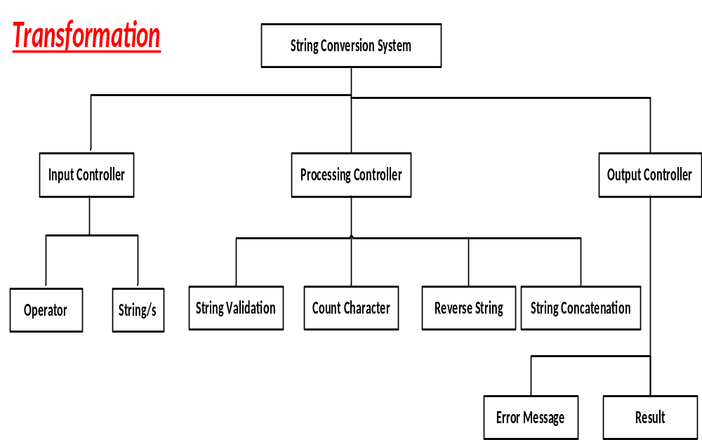

Slide 15
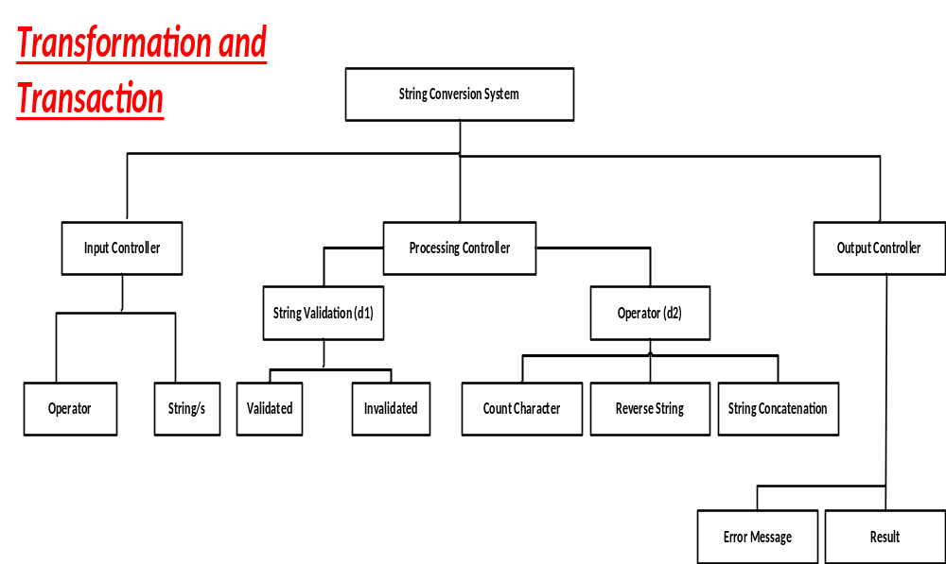

Slide 16
